Slide 1
Bluetooth Low Energy Peripherals
A Primer and Demo

Slide 2
Introduction – Steven Knudsen
B.Sc. Computer Engineering 1984 U of A
M.Sc. Applied Sciences in Medicine 1987 U of A
Ph.D. Electrical Engineering 1993 U of C
P.Eng. APEGA
5 startups, 2 as co-founder
Lecturer, Professor, Researcher (Wissenschaftlicher Mitarbeiter)
Jr./Sr./Chief Engineer, VP Engineering, CTO
Consultant
Software, Hardware, Algorithms
Boundary Problems
Notes:
signal processing signal processing signal processing signal processing signal processing signal processing ubiquitous IoT ubiquitous IoT ubiquitous IoT pervasive pervasive pervasive RF RF SDR SDR SDR SDR radiofrequency NMR MRI satellite imaging imaging mathematics programming programming Arduino Arduino Raspberry Pi Raspberry Pi Raspberry Pi Onion Photon Duo Electron Java C C++ ObjC Swift Java Linux Linux Linux OSX OSX iOS iOS iOS Android Android embedded Wifi 802.11 802.11 Bluetooth

Slide 3
Main Topics

Slide 4
BLE basics
Central and Peripheral roles
Client and Server roles
Services and Characteristics
SIG-defined services, etc.
Example
Hardware (Peripheral) to accept data
iOS App (Central) to access the peripheral
Q&A

Slide 5
Bluetooth Low Energy Basics

Slide 6
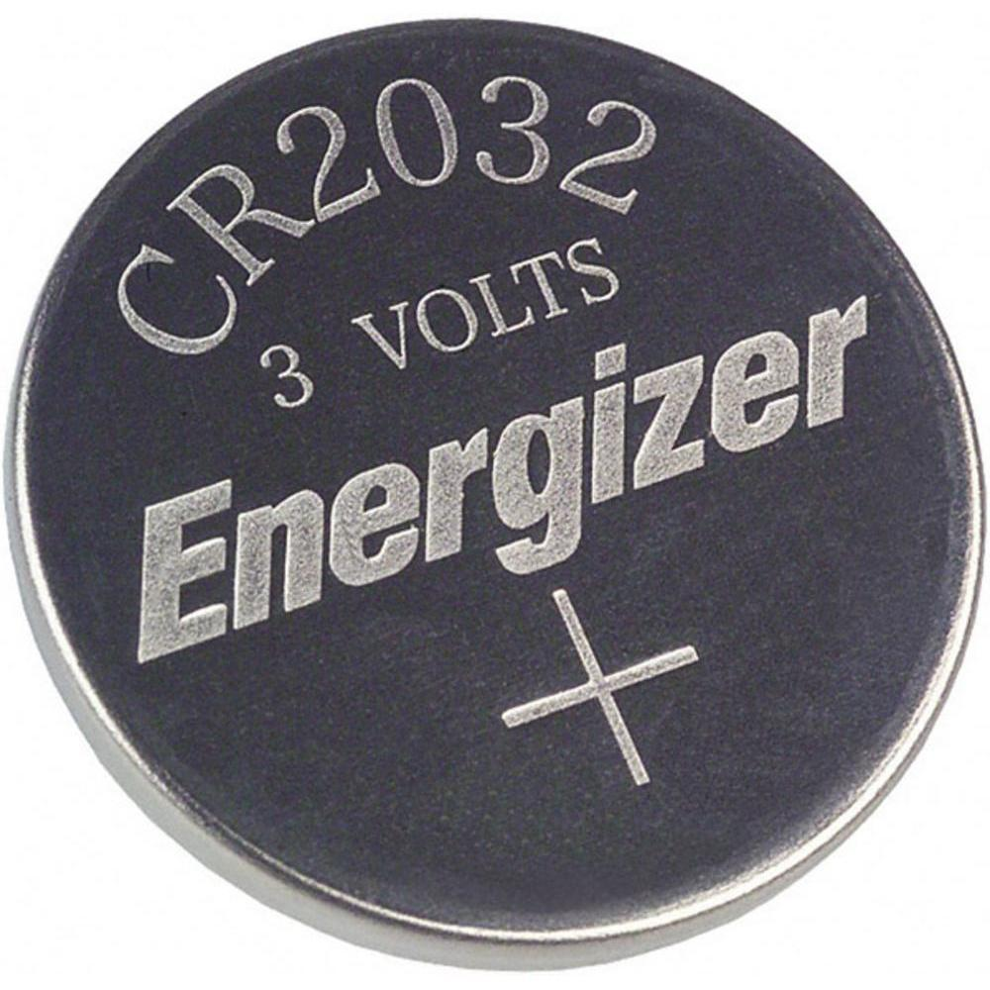
Bluetooth Low Energy (BLE)
Extension to Bluetooth 4.0, but not really like the main spec
Think of as a light-weight subset of Bluetooth
Not meant for transferring a lot of data
Developed independently of Bluetooth as in-house Nokia project; “Wibree”
Designed to support very low power applications
Small battery-powered devices that do not require much data or frequent transfers

Slide 7
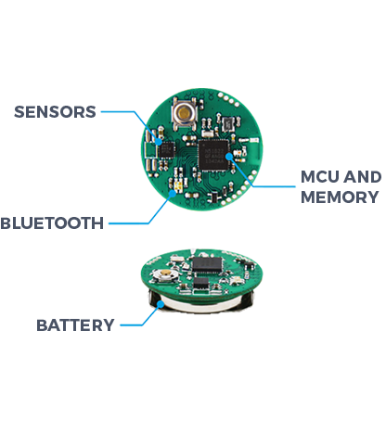
Example device - MbientLab
Motion tracker
accelerometer + gyroscope
barometer + temperature
magnetometer
ambient light sensor
Peripheral queried by phone or other BLE “Central”
Notes:
Findability applications – Tile
Beacons – provide a small amount of location-specific info

Slide 8
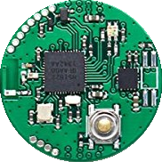
Primary Use Case – Simple Info
I’m here!
I’m here!

Slide 9
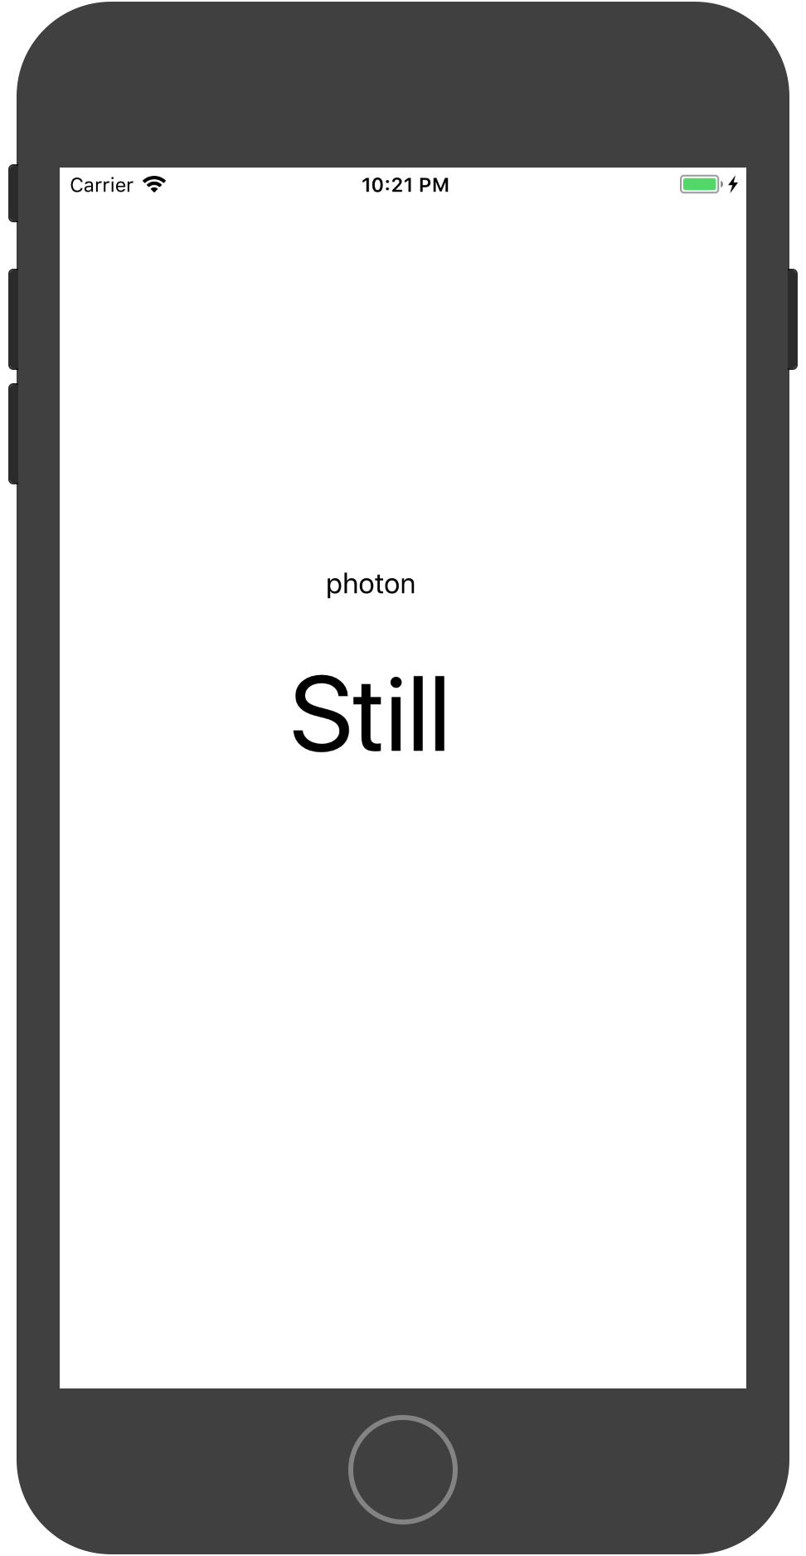
Device discovery
Heard you.
Can we talk?

Slide 10
Sure.

Slide 11
Service discovery
I see your services. Tell me more about that one.

Slide 12
Service characteristics inquiry
It has these characteristics

Slide 13
Data exchange
Great.
Give me the data for that characteristic.

Slide 14
Here you go…

Slide 15
Transactional
Thanks.
Goodbye.
23C
97 kPa

Slide 16
Independence
I’m here!
I’m here!

Slide 17
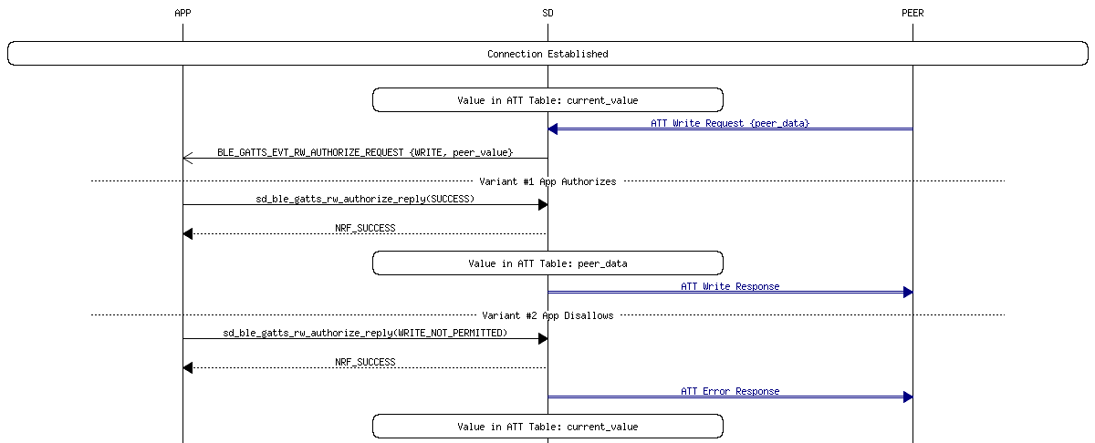
https://devzone.nordicsemi.com/documentation/nrf51/5.2.0/html/modules.html
Notes:
Sure, could have shown all the previous slides more succinctly with a message sequence chart, but that’s boring and probably has too much detail.
That said, there are lots of great online resources including this one by Nordic Semiconductor, who make the very popular and capable nRF series of transceivers.

Slide 18
States and Actions
Standby
Scanner
Initiator
Idle
Device Discovery
Connection
Advertiser
Responder
Notes:
Idle – standing by, Bluetooth may be turned on, but not active. May even be in a deep sleep state
Discovery – where peers find each other, by scanning, advertising, or alternating both
Connection – two peers have a mutual interest and connect to pass on or exchange data

Slide 19
States and Actions - Idle
Standby
Scanner
Initiator
Idle
Device Discovery
Connection
Advertiser
Responder
Peripheral
Central
Notes:
We tend to think of the peripheral as the less capable device, but

Slide 20
States and Actions - Idle
Standby
Scanner
Initiator
Idle
Device Discovery
Connection
Advertiser
Responder
Central
Peripheral
Notes:
Nothing says it has to be so. A device can be what it wants when it wants.

Slide 21
States and Actions – Device Discovery
Standby
Scanner
Initiator
Idle
Device Discovery
Connection
Advertiser
Responder
Peripheral
Central
Notes:
In device discovery, the Central scans for peripherals, which are advertising their availability.

Slide 22
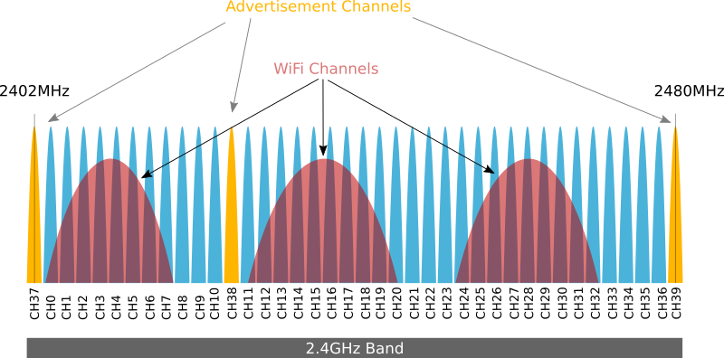
Notes:
Advertise on up to 3 channels spaced to avoid the most used WiFi channels.
Usually set up to advertise on all three, hopping between them at prescribed intervals.

Slide 23
States and Actions – Connection
Standby
Scanner
Initiator
Idle
Device Discovery
Connection
Advertiser
Responder
Request
Response
Server
Client

Slide 24
States and Actions – Connection
Standby
Scanner
Initiator
Idle
Device Discovery
Connection
Advertiser
Responder
Notify (with or without data)
Notify (with or without data)
Server
Client

Slide 25
States and Actions – Connection
Standby
Scanner
Initiator
Idle
Device Discovery
Connection
Advertiser
Responder
Read 20 bytes at a time
Notify – have N bytes of data
Server
Client

Slide 26
BLE Stack
App
Applications
Host
Generic Access Profile (GAP)
Generic Attribute Profile (GATT)
Attribute Protocol (ATT)
Security Manager
Logical Link Control and Adaptation Protocol (L2CAP)
Host Controller Interface (HCI)
Controller
Link Layer (LL)
Physical Layer (PHY)
Direct Test Mode

Slide 27
GAP – Generic Access Profile GATT – Generic Attribute Profile
GAP defines the general topology of a network.
Central
Peripheral
GATT describes how attributes are organized for transfer once devices are connected
Client
Server

Slide 28
GAP – Communication Mechanisms
Broadcasting
Devices don’t have to connect
Broadcaster transmits public advertising data packets with a small amount of data
Observer listens for broadcast packets
Connecting
More common that Broadcasting
Devices connect and handshake to exchange data
Peripheral advertises (beacons) so central devices can connect
Central initiates connection after hearing beacon; can be refused by peripheral

Slide 29
ATT – Attribute Protocol
Based on Client ⇔ Server relationship.
Server exposes a set of attributes to a client that are accessible using the attribute protocol
Attribute is a discrete value comprising
Type defined by UUID. Short, 16 bit, for SIG-assigned. Long, 128 bit, for custom.
Handle
Permissions
Notes:
The Generic Attribute Profile is based on the Attribute Protocol, so best to start with it.

Slide 30
ATT – Attribute Protocol examples
Heart Rate Service | Handle | Type of attribute (UUID) | Attribute permissions | Attribute values
Service Declaration | 0x000C | Service declaration Standard UUID_{service} 0x2800 | Read Only, No Authentication, No Authorization | Heart Rate Service 0x180D
Characteristic Declaration | 0x000D | Characteristic declaration Standard UUID_{characteristic} 0x2803 | Read Only, No Authentication, No Authorization | Properties (notify), Value Handle (0x000E), UUID for Heart Rate Measurement characteristic (0x2A37)
Characteristic Value Declaration | 0x000E | Heart Rate Measurement Characteristic UUID found in the Characteristic declaration value 0x2A37 | Higher layer profile or implementation specific | Beats Per Minute e.g. “167”
Descriptor Declaration | 0x000F | Client Characteristic Configuration Descriptor (CCCD) Standard UUID_{CCCD} 0x2902 | Readable with no authentication or authorization. Writable with authentication and authorization defined by higher layer specification or is implementation specific | Notification enabled 0x000X
Characteristic Declaration | 0x0010 | Characteristic declaration Standard UUID_{characteristic} 0x2803 | Read Only, No Authentication, No Authorization | Properties (Read), Value Handle (0x0011), UUID for Body Sensor Location (0x2A38)
Characteristic Value Declaration | 0x0011 | Body Sensor Location UUID found in the Characteristic declaration value 0x2A38 | Higher layer profile or implementation specific | Sensor Location (8-bit integer) e.g., 3 equals “finger”
Short, so standard from Bluetooth SIG
Values can be anything, including UUID or other info
Permissions apply only to values

Slide 31
GATT
Profile
Service
Characteristic
Characteristic
Descriptor
Characteristic
Service
Characteristic
Descriptor
Characteristic

Slide 32
Main Development Context
Standby
Scanner
Initiator
Idle
Device Discovery
Connection
Advertiser
Responder
Peripheral
Central

Slide 33
Example

Slide 34
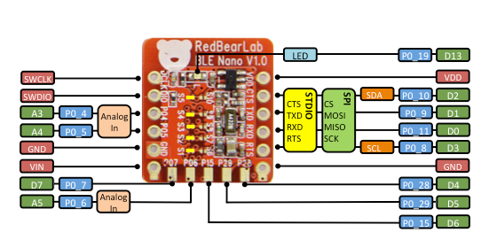
Redbear.com BLE Nano
Nordic nRF51822 SoC supports both BLE Central and BLE Peripheral roles
Ultra low power consumption
Support voltage from 1.8V to 3.3V
Software development using mbed.org, GCC, Keil or Arduino

Slide 35
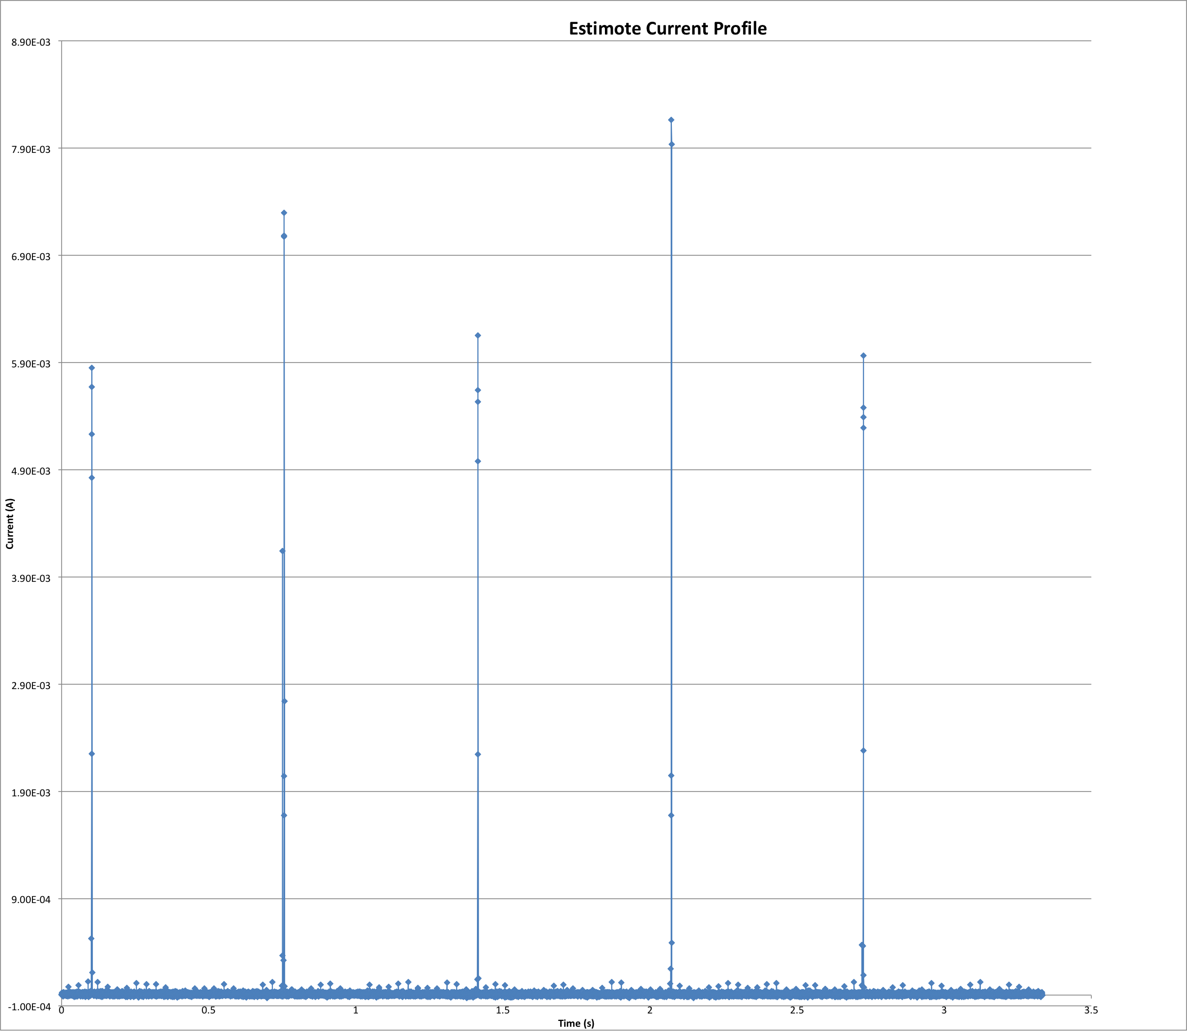
Measured power consumption
24 µA average for 660 ms interval
CR2032 has 240 mAh
240000 µAh / 24 µA = 10,000 hours
416 days

Slide 36
Peripheral/Server – BLE Nano
mbed.org is the development environment. Lots of examples – “BleNanoLed”
Advertises on a 100 ms interval
Defines one service with two characteristics
We use only one characteristic that accepts data without requiring an authorization, authentication, or a response
Client writes up to 20 bytes at a time, but we need only one

Slide 37
Device name is part of advertising info, i.e., local “data”
main.cpp

Slide 38
No need to advertise when connected implied. Save power…
Usual to have callbacks so that BLE managers can let the application do something interesting

Slide 39
Set up callbacks
Set up services
Low latency, but power draining
Events handled asynchronously in callbacks
End of main.cpp

Slide 40
Service and characteristics UUIDs definition
Can write to peripheral with no authentication, no authorization, and don’t need a response
Only allows notification
Defines service for base UUID + characteristics
Service definition

Slide 41
We will write to the TX characteristic. The value is parsed here…
Write and read handlers

Slide 42
LED control

Slide 43
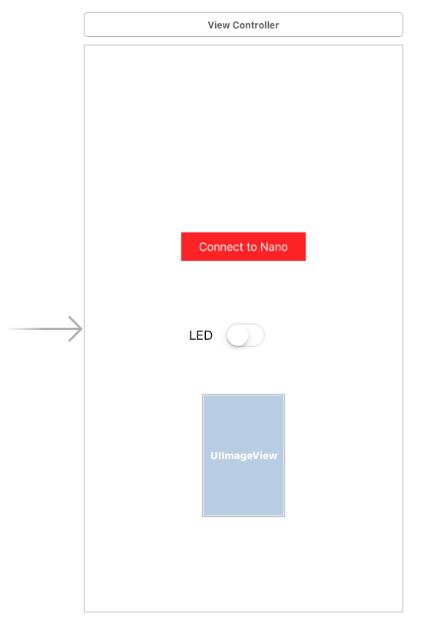
iOS App
Main steps
Listen for advertising peripherals
Filter on device “BLENano”
Connect to peripheral if match
Confirm device has desired service and characteristics
Use TX characteristic to control LED
Simple single-view app
Have to run on iPhone since simulator doesn’t do Bluetooth
https://github.com/knud/HackEDBLE

Slide 44
Make this the target for callbacks
My own wrapper for iOS Core Bluetooth

Slide 45

Check for desired service
Should have progress indicator
Confirm

Slide 46
If TX characteristic, we are in business
Confirmed! Get characteristics

Slide 47
Demo

Slide 48
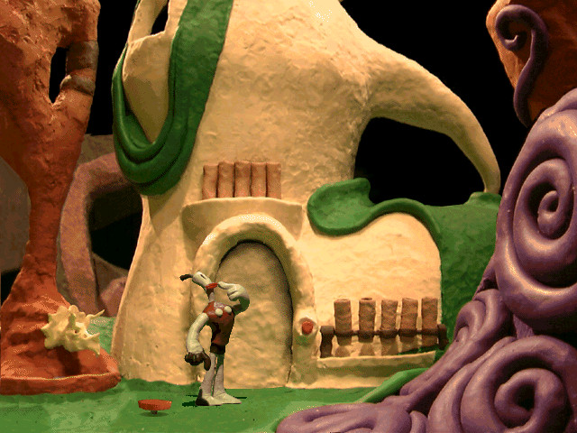
Q&A
Notes:
Here are two examples that are pretty simple, but solve real world problems, and can be done using the tools we have here today.

